Slide 1
Impact of Car Features on Price and Profitability
Presented By : Rahul Vishwakarma

Slide 2
Project Description
The automotive industry is rapidly evolving with a focus on:
Fuel efficiency
Environmental sustainability
Technological innovation
Consumer preferences are shifting due to:
Rising interest in electric, hybrid, and alternative fuel vehicles
Sustained demand for traditional gasoline-powered cars
Business Problem
Understanding how various car features influence pricing and profitability is critical for automotive manufacturers
and dealers aiming to make informed, data-driven decisions. By identifying which attributes most significantly impact
vehicle pricing and drive profitability, companies can refine their product development, marketing strategies, and sales approaches.
This analysis will uncover the key features that contribute to higher value, enabling manufacturers to strategically optimize their offerings
to align with market demand and maximize returns.

Slide 3
APPROACH:
After downloading the dataset, I began by selecting the entire data range and inserting it into an Excel table for better handling and organization. I then converted the table back to a normal range to enable flexible data cleaning operations. Using the =COUNTBLANK formula, I identified and removed any blank or empty columns that did not contribute meaningful information. As a result of this initial cleaning process, the final dataset consists of 11,813 rows and 16 well-defined columns, ready for further analysis.
I applied a comprehensive data analysis strategy combining multiple analytical methods to derive meaningful insights from the dataset:
Descriptive Analysis: Calculated the mean and other statistical measures for numerical variables to understand the central tendency and distribution.
Predictive Analysis: Performed linear regression to evaluate how different features influence car pricing and to forecast pricing trends.
Diagnostic Analysis: Conducted correlation analysis to identify relationships between key variables and determine which features are most strongly associated with price.
Exploratory Data Analysis (EDA): Used various visualization techniques—including scatter plots, bubble charts, and distribution charts—to uncover patterns, outliers, and data trends.
This multi-layered analytical approach enabled a deeper understanding of the dataset and supported evidence-based decision-making for pricing and product development.

Slide 4
All the analysis has been performed in excel. This tool is also used to create graphical representation of the results and to understand the result set better.

Slide 5
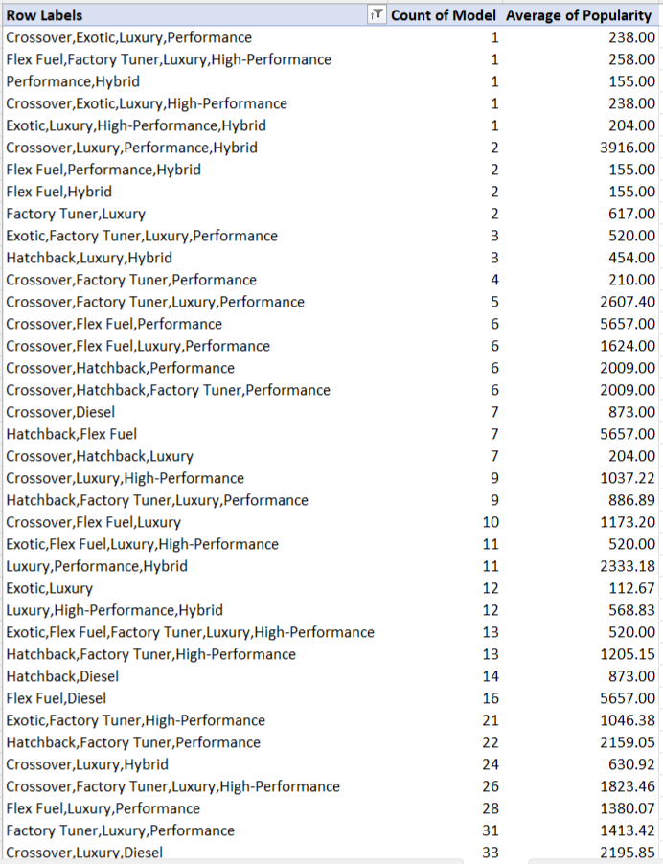
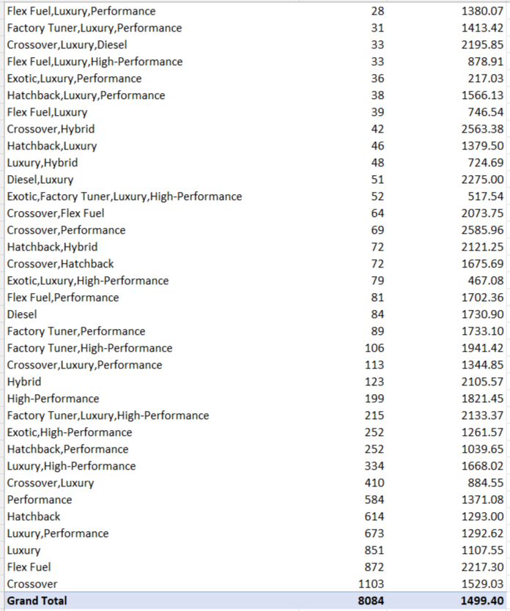
Task 1.A: Create a pivot table that shows the number of car models in each market category and their corresponding popularity scores.

Slide 6
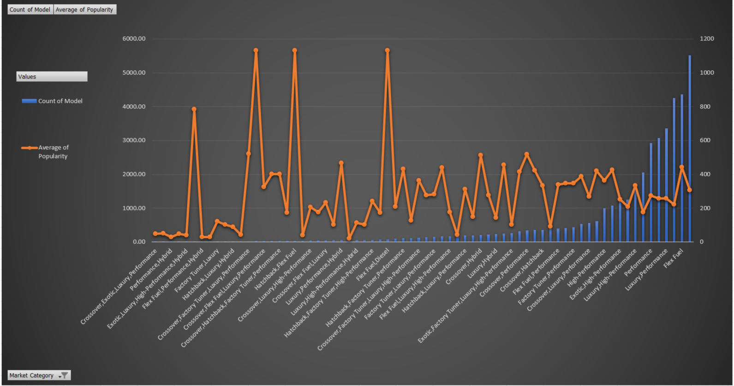
Task 1.B: Create a combo chart that visualizes the relationship between market category and popularity.

Slide 7
INSIGHTS :-
Certain car types like “Hatchback, Flex Fuel”, “Flex Fuel, Diesel”, and “Crossover, Flex Fuel, Performance” have very few models available, but they are extremely popular among buyers. This means that even though choices in these types are limited, demand is high for what does exist.
The crossover segment is the largest with 1,103 different models, showing it’s the most widely available and possibly the most versatile choice for buyers.
Cars labeled “Exotic” or “Luxury” often have much lower popularity. This could be because these vehicles usually come with very high price tags, making them affordable only for a few wealthy buyers.
For example, the “Crossover, Luxury, Performance, Hybrid” category only has 2 models, but it’s highly popular (popularity score: 3916). This tells us that when a rare combination of features hits the market, many people want it.
Similarly, luxury model types like “Hybrid, Performance, Hybrid”, “Flex Fuel, Factory Tuner, Luxury, High-Performance”, and “Crossover, Exotic, Luxury, Performance” have only a single model each, making them rare finds. Even with just one option, they attract attention—especially if it covers multiple desirable features.
Models that combine many features like “Crossover, Exotic, Luxury, High-Performance” and “Exotic, Luxury, High-Performance” are very rare, with just one model available in the market. Such cars are often exclusive and target a small segment of buyers.
While car buyers have many choices, the most common types (like crossovers) dominate the market. However, some rare models with niche combinations of features are in high demand even if only a few exist. Expensive luxury and exotic cars tend to be less popular, probably because they are out of reach for most people.

Slide 8
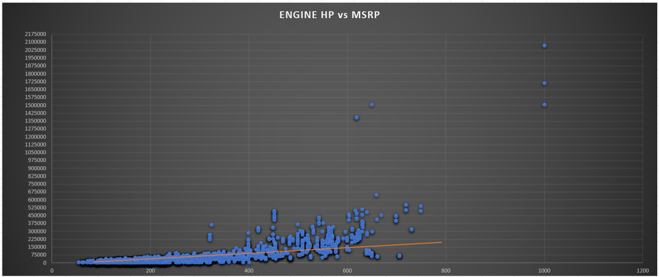
Task 2: Create a scatter chart that plots engine power on the x-axis and price on the y-axis. Add a trendline to the chart to visualize the relationship between these variables.

Slide 9
INSIGHTS :-
Cars with higher engine horsepower (HP) usually have a higher price (MSRP), but the relationship isn’t very strong—there are many exceptions.
Most cars cluster on the left and lower part of the chart, meaning most vehicles have lower horsepower and cost less.
A few cars with extremely high horsepower (over 650 HP, up to about 1000 HP) are priced much higher—some even cost over 2 million! These are likely supercars or premium models.
For the same horsepower, car prices can vary a lot, showing that other features (brand, luxury, design, technology) also influence price.
There are a few cars with much higher prices than others for their horsepower, suggesting that rarity or luxury influences price more than just engine power.
In the scatter plot graph trendline moving upward and it is showing the positive relationship between price and engine power, it means as the engine power increasing price is also increasing.

Slide 10
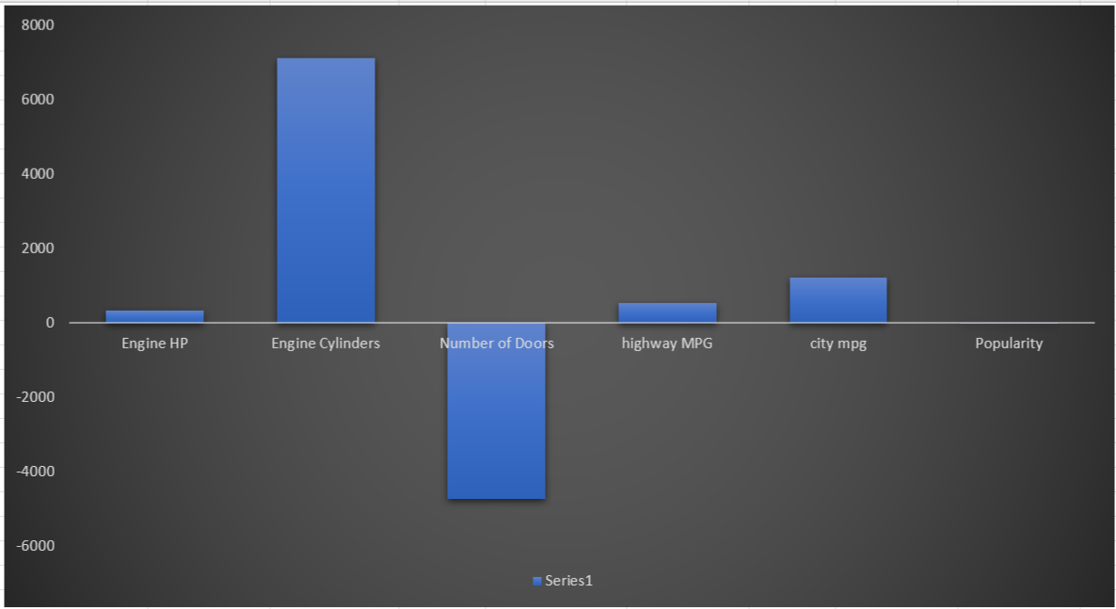
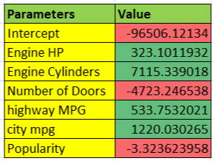
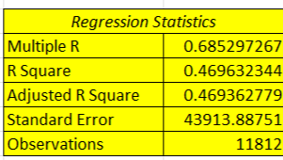
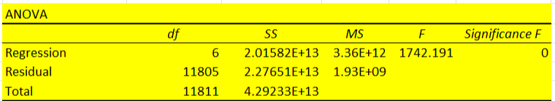
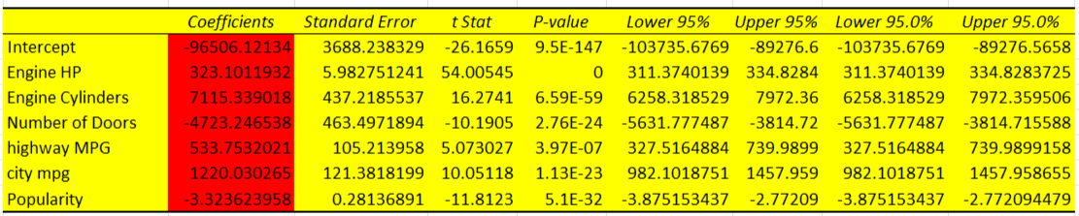
Task 3: Use regression analysis to identify the variables that have the strongest relationship with a car's price. Then create a bar chart that shows the coefficient values for each variable to visualize their relative importance.

Slide 11
INSIGHTS :-
Based on the regression analysis, we found that Engine Horsepower, Engine Cylinders, Highway MPG, and City MPG all have a positive and important connection with car prices.
Cars with more engine horsepower usually cost more. The more powerful the engine, the higher the price.
Cars with more engine cylinders tend to be cheaper in this model. This might be because today’s luxury cars don’t rely on cylinder count for cachet.
Cars with more doors (like 4-door sedans) typically cost less. Sportier, more expensive cars often have only two doors.
Cars with good city fuel economy also have higher prices—good mileage is valuable.
The more popular a car is, the less it tends to cost, likely because popular cars are mass-produced and more affordable.
In the graph, Engine Cylinders show the strongest positive link to price, meaning more cylinders usually mean a higher price.
On the other hand, the Number of Doors has the strongest negative connection, which means that as the number of doors increases, the car price tends to go down.

Slide 12
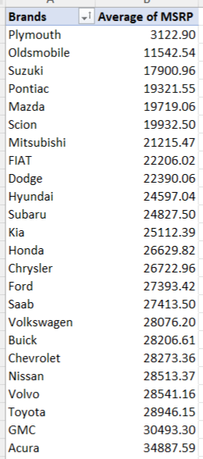
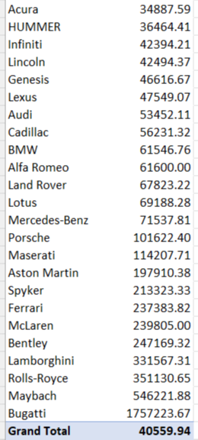
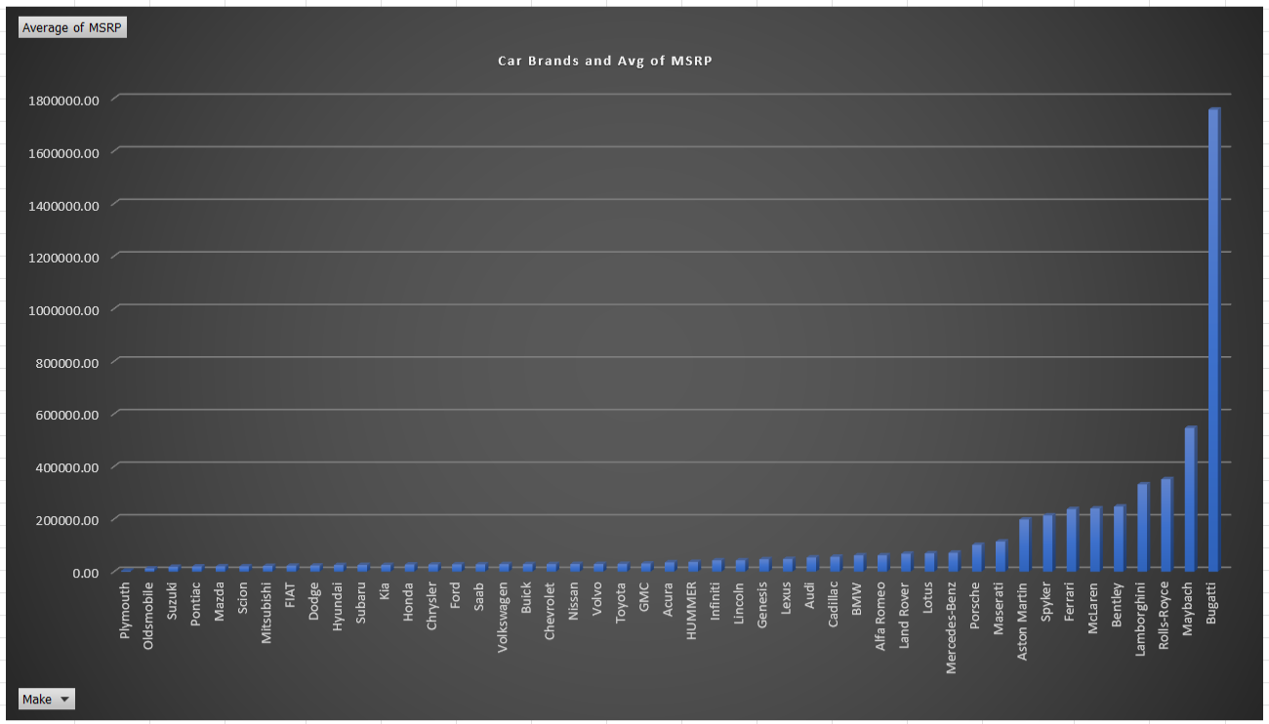
Task 4.A: Create a pivot table that shows the average price of cars for each manufacturer. Task 4.B: Create a bar chart or a horizontal stacked bar chart that visualizes the relationship between manufacturer and average price.

Slide 13
INSIGHTS :-
Some car brands have much higher average prices than others. For example, Plymouth has an average price of just $3,123, while Bugatti tops the list with $1,757,223!
Brands like Bugatti, Maybach, Rolls-Royce, Lamborghini, Bentley, and Ferrari are by far the most expensive. These are known for luxury, exclusivity, and high performance.
Popular brands like Honda, Toyota, Ford, Hyundai, Kia, and Nissan have average prices between $20,000 and $30,000, making them much more affordable for the average person.
Brands such as BMW, Audi, Cadillac, and Mercedes-Benz sit in the middle range—they’re more expensive than basic brands but still far less than the ultra-luxury names.
Cars from brands like Bugatti, Maybach, and Rolls-Royce have prices that are off the charts compared to all other cars. These are special cars aimed at super-rich buyers.
Even though we hear a lot about luxury brands, most cars people buy are from the cheaper, everyday brands.
When you average all the brands together, the typical car costs about ₹40,560, but this number is pulled up by the very high prices of a few luxury brands.
High-end brands charge much more because of luxury features, brand prestige, and limited production. Cheaper brands focus on affordability and practicality.

Slide 14
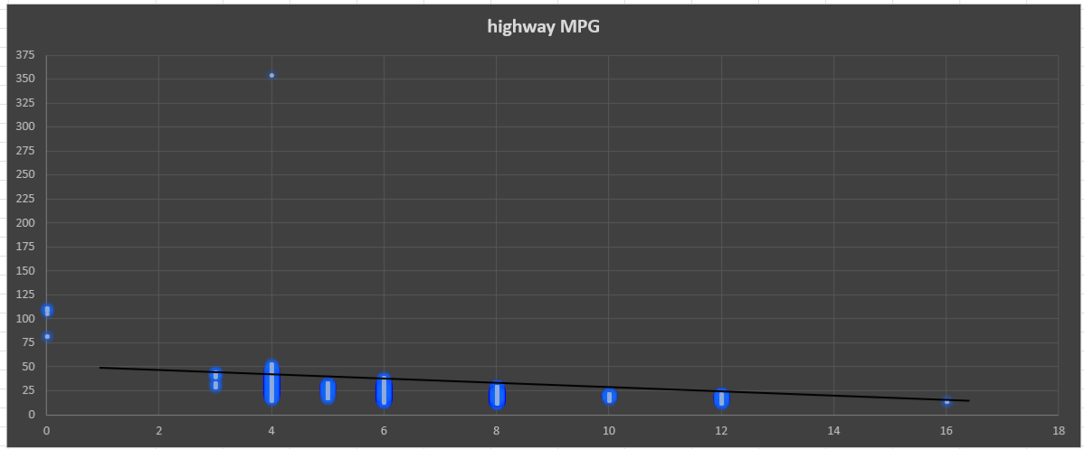

Task 5.A: Create a scatter plot with the number of cylinders on the x-axis and highway MPG on the y-axis. Then create a trendline on the scatter plot to visually estimate the slope of the relationship and assess its significance.
The scatter plot clearly shows that as the number of engine cylinders goes up, a car’s highway MPG usually goes down. This means cars with bigger engines (more cylinders) are generally less fuel-efficient on highways.
The trendline in the plot slopes downward, showing this negative relationship. The drop isn’t subtle—there’s a strong and noticeable decrease in MPG with each step up in cylinder count.
The spread of the dots clusters nicely around the trendline, which suggests this is a real, consistent trend and not a random pattern.

Slide 15
Task 5.B: Calculate the correlation coefficient between the number of cylinders and highway MPG to quantify the strength and direction of the relationship.
Strong Negative Correlation:
The correlation coefficient (a number that measures how strong and in which direction two things are related) between number of cylinders and highway MPG is about -0.62.
The negative value tells us “as one goes up, the other goes down.”
The size of the number (-0.62) means the link is fairly strong, but not perfect. So, engine cylinders do a good job predicting highway MPG for most cars.
Cars with more engine cylinders are usually a lot less efficient on the highway. If you want to save fuel and money, go for a car with fewer cylinders.

Slide 16
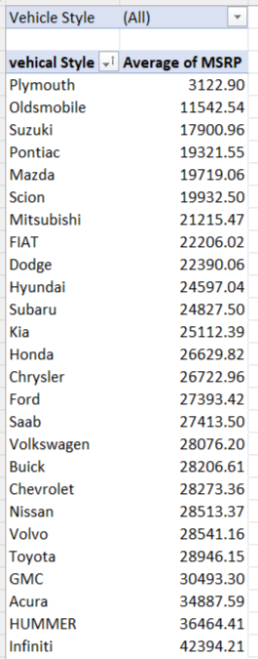
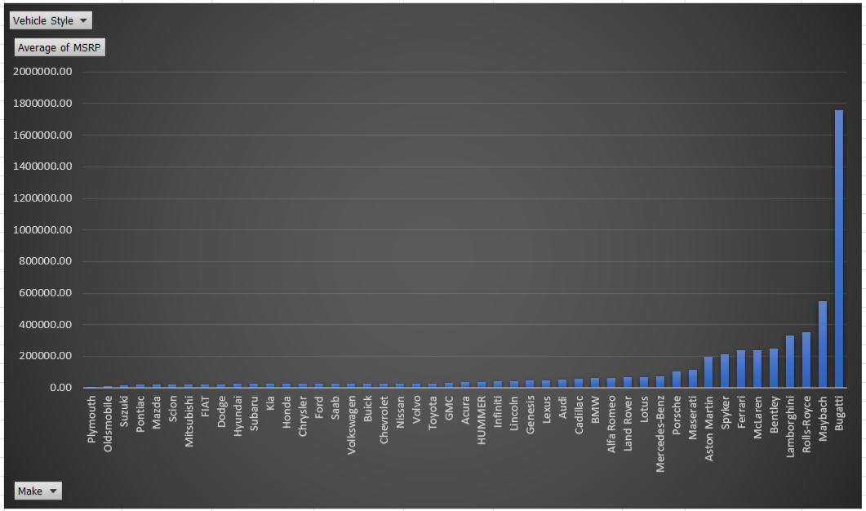
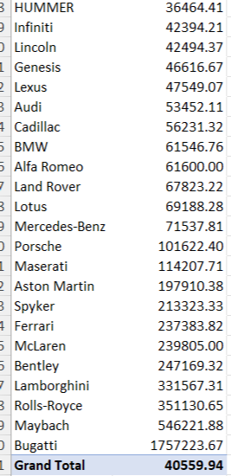
Task 1: How does the distribution of car prices vary by brand and body style?
I have calculated the total car prices (MSRP) for each combination of body style and brand name. Next, I created column charts that display how car prices are distributed across different brands and body styles. Also, I added a slicer to the chart, which lets you filter and view the data by different vehicle styles.

Slide 17
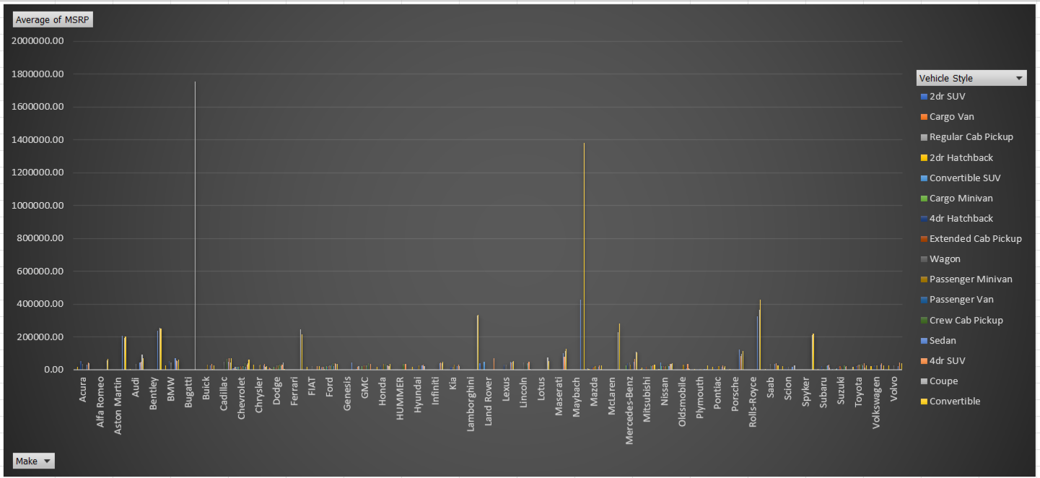
Task 2: Which car brands have the highest and lowest average MSRPs, and how does this vary by body style?
Bugatti has the highest average car price for coupes compared to any other brand, with Maybach taking the second spot for convertibles.
On the other hand, Plymouth offers the lowest average prices of all the car brands.

Slide 18
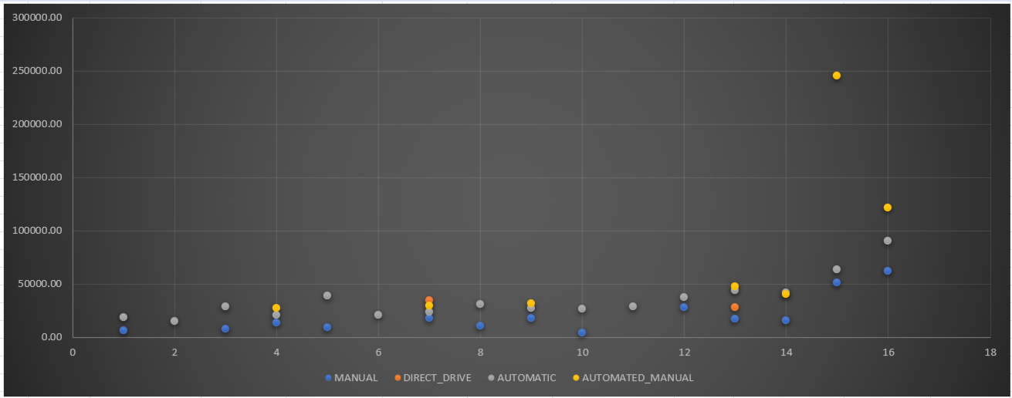
Task 3: How do the different feature such as transmission type affect the MSRP, and how does this vary by body style?
Cars with automatic gears usually cost more than manuals because automatics are fancier and easier to drive.
Manuals are cheapest and mostly found in hatchbacks and basic sedans. Go for these if you want to save money.
Special gears like AMT and direct drive are usually priced between manuals and automatics, but sometimes cost more in luxury cars.
Automated manual transmissions are only found in top luxury brands like Bugatti, Maybach, Lamborghini, Ferrari, and Bentley. Cars with this type of transmission also have a very high average price.
In SUVs and luxury cars, automatics are almost standard, so these types are pricier.
If you pick an automatic in a cheaper body style, you'll still pay more than for a manual.
Bottom line: Automatic = more expensive, manual = cheaper, and your choice also depends on what type of car you buy.

Slide 19
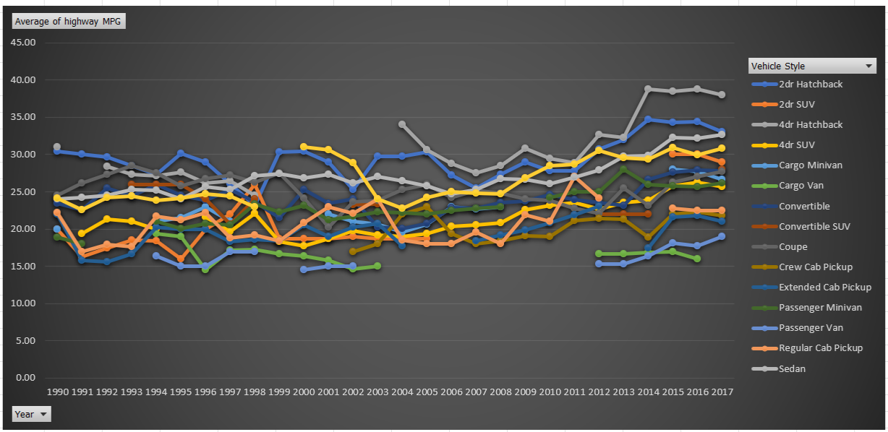
Task 4: How does the fuel efficiency of cars vary across different body styles and model years?
4-door hatchbacks have the best fuel efficiency, getting close to 38 km per liter—higher than all other body styles.
2-door hatchbacks are also excellent when it comes to mileage, taking the second spot.
Sedans rank just after hatchbacks, also offering very good fuel economy.

Slide 20
INSIGHTS :-
Smaller cars like hatchbacks and compact sedans are generally the most fuel-efficient, often getting more than 18–20 km/l, while SUVs and big cars usually have lower mileage unless they’re hybrids.
Over the years, cars have gotten more fuel-efficient. Newer models today use less fuel thanks to better engines, lighter materials, and more hybrid options compared to cars from 20 years ago.
Sports cars, luxury sedans, and big SUVs are usually less fuel efficient.
Hybrids and CNG cars give the best mileage, even when they’re bigger; some midsize hybrid SUVs now go over 27 km/l.
Pickup trucks and vans are usually the least efficient but have improved with diesel engines or hybrid tech in newer models.
There’s a clear trend: fuel efficiency keeps getting better every year, mainly because of advances in technology and stricter rules.
Electrification—such as hybrid and electric vehicles—pushes mileage even higher, helping big cars get closer to small-car fuel economy.
If you want to save on fuel, choose a small hatchback or a hybrid. Trucks and SUVs will use more fuel, but choosing a newer model or hybrid can help lower costs.
No matter the body style, buying a newer car almost always means better mileage than an old one.

Slide 21
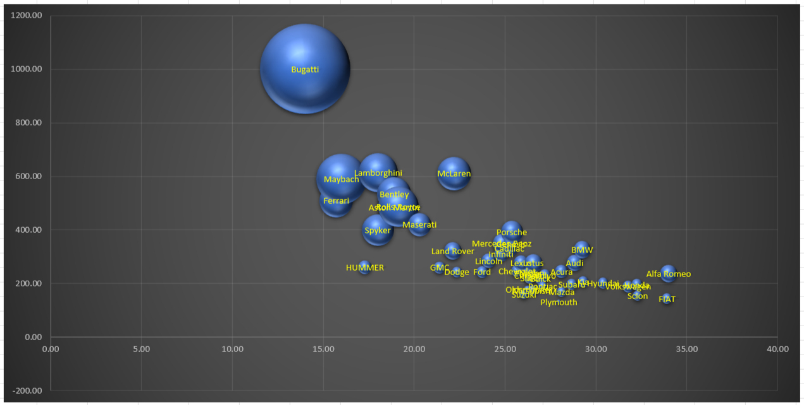
Task 5: How does the car's horsepower, MPG, and price vary across different Brands?
4-door hatchbacks have the best fuel efficiency, getting close to 38 km per liter—higher than all other body styles.
2-door hatchbacks are also excellent when it comes to mileage, taking the second spot.
Sedans rank just after hatchbacks, also offering very good fuel economy.

Slide 22
INSIGHTS :-
Car brands vary widely in horsepower, MPG (mileage), and price.
Luxury brands like Bugatti, Lamborghini, and Ferrari top the charts for horsepower, often well above 1,000 hp, and have the highest prices—sometimes over ₹1 crore or even more.
Mainstream brands like Toyota, Honda, Hyundai, Kia, and Ford offer cars with more moderate horsepower—typically around 120–180 hp—and are much more affordable.
Fuel efficiency (MPG) is generally best in brands that focus on small cars and hybrids, like Toyota (Hyundei, Camry Hybrid), Maruti Suzuki, and Honda (City Hybrid), with some models achieving 23–28 km/l (about 55–65 mpg), especially in hybrid variants.
Luxury and sports brands focus less on fuel efficiency—supercars and high-performance sedans (Bugatti, Lamborghini, Bentley, Rolls-Royce) get much lower MPG, but deliver top speed and power.
Price gaps are huge: Luxury/supercar brands are in a completely different league price-wise compared to everyday brands. For example, a Bugatti can cost more than ₹1.75 crore, while cars from brands like Maruti Suzuki or Tata can start below ₹5 lakh.
Mid-range and premium brands, like BMW, Audi, and Mercedes-Benz, provide a balance. They generally offer higher horsepower and better features than entry-level brands, but with better fuel efficiency and prices still far below the supercar category.
Affordable brands offer lower power, higher mileage, and lower prices; performance and luxury brands offer high horsepower, lower mileage, and much higher prices. Brand choice dramatically affects what you get in terms of power, fuel efficiency, and cost.
High-end brands like Bugatti and Maybach have higher horsepower and prices, while brands like Suzuki focus on fuel efficiency and higher mileage. Generally, as horsepower increases, so does price. In some brands, higher MPG means lower prices. BMW offers top engine power but low mileage.

Slide 23
This analysis provided valuable insights into how various car features influence pricing and profitability. By applying these findings, automotive companies can make smarter decisions to optimize their product lines, pricing models, and marketing strategies, ultimately improving profitability. This report highlights the key results of the project and suggests actionable recommendations based on the data. Key findings : Luxury brands like Bugatti and Ferrari are very pricey, while brands like Toyota and Honda are affordable. Cars with fewer cylinders use less fuel, making them cheaper to run. Cars with higher horsepower tend to have higher prices and generate better profit margins, showing a clear positive impact on profitability. Features like engine power, fuel efficiency, and brand name strongly affect car prices. Fuel-efficient vehicles generally have a negative correlation with price; however, they attract a dedicated segment of buyers focused on economy and sustainability. Brand prestige is the strongest predictor of both price and profitability—cars from prestigious brands command significantly higher prices and profits. Choosing the right mix of features can help buyers save money and still get a great car. Throughout this project, I enhanced my data analysis skills using Excel tools such as regression analysis, pivot tables (for averages and sums), and visualization techniques like bubble and scatter charts. This experience greatly improved my exploratory data analysis capabilities and strengthened my ability to derive meaningful insights from complex data, helping me support sound decision-making and contribute to impactful business outcomes.
Conclusion

Slide 24
Thank You

